Slide 1
Team Melon
Group Software Development Project 2017
Modupeh Betts, Andrew Knowles, Nadim Rahman, Madeleine Rhodes

Slide 2
Introduction
Aim of Melonomics
Documentation available on GitHub:
https://github.com/Melon-Heads/mastermelon

Slide 3
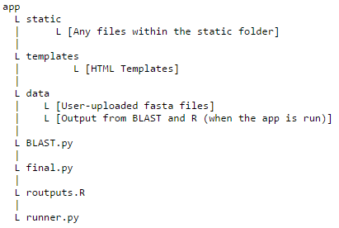
The Application
Flask Framework
App routes (Logic)
HTML Templates (pages)
CSS (style)
JavaScript (Dynamism)
Integral to all software components

Slide 4
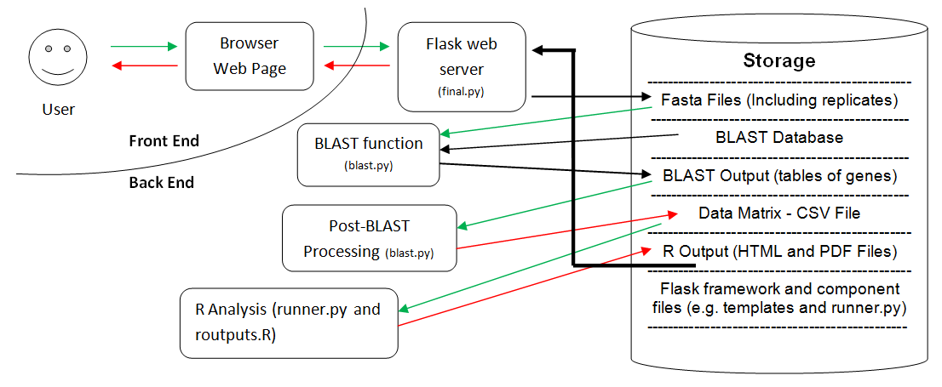
Software Architecture
Input
Output
Data flow

Slide 5
BLAST
Input = Fasta files
Uses Biopython and BLAST+
Locally Hosted
BLASTs all files within each data directory against database
Notes:
Have example BLAST output ready.
The BLAST function takes fasta files (.fasta suffix).
Biopython packages and BLAST required to run the function. This enabled for standalone BLAST to be carried out → NcbiblastnCommandline
This is carried out locally to reduce the time taken to receive results, allows more control of computing power.
All files within the separate data directories are BLASTed, therefore this provides scope for improvements described later.
Describe parameters in example.

Slide 6
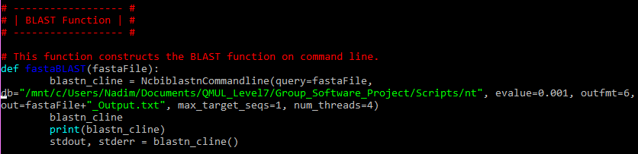
Example of BLAST
Example:

Slide 7
BLAST Output (Post-Processing)
Output Format:
query_ID; subject_ID; %_Identity; alignment_length; mismatches; gap_opens; query_Start; query_End; evalue; bit_score
Subject ID (gene ID) and FPKM value from query ID are parsed
Matrix is generated using python pandas
Saved in a csv file
Notes:
Have BLAST output ready.
Gene IDs and FPKM values are put into dictionaries.
An additional dictionary used to separate the data to samples.
Dictionaries compatible with the matrices of python pandas.
CSV file is required as it is easy to be brought into the R environment, where analysis happens.
Describe the CSV file. Some improvements(?)

Slide 8
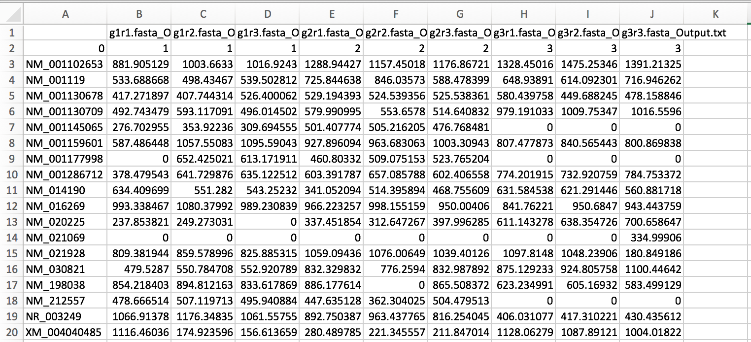
CSV Matrix

Slide 9
R
Input = CSV file of matrix
Analysis:
Principal Component Analysis
Heatmaps with associated dendrograms
Hierarchical Cluster Analysis
Top 20 Genes
Volcano Plots

Slide 10
Limitations- opportunities for further development
Online Deployment
Number of Sample Types
Multiple Users
Reducing BLAST time
Sequences matching to the same gene
Advanced BLAST Parameters
Tailored R Analysis
Dendrogram distance and cluster methods
Notes:
Tailored analysis refers to incorporating a feature which allows users to choose different variables for the R analysis, e.g. give them options to choose what type of distance and clustering methods to use.

Slide 11
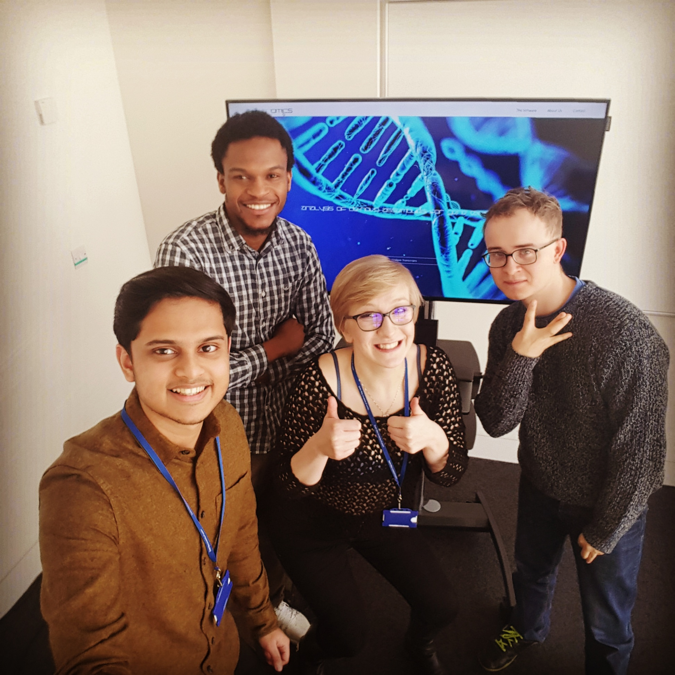
Any Questions?

